Slide 1

Chapter 3 Transport Layer
A note on the use of these PowerPoint slides:
We’re making these slides freely available to all (faculty, students, readers). They’re in PowerPoint form so you see the animations; and can add, modify, and delete slides (including this one) and slide content to suit your needs. They obviously represent a lot of work on our part. In return for use, we only ask the following:
If you use these slides (e.g., in a class) that you mention their source (after all, we’d like people to use our book!)
If you post any slides on a www site, that you note that they are adapted from (or perhaps identical to) our slides, and note our copyright of this material.
For a revision history, see the slide note for this page.
Thanks and enjoy! JFK/KWR
All material copyright 1996-2020
J.F Kurose and K.W. Ross, All Rights Reserved
Computer Networking: A Top-Down Approach 8th edition Jim Kurose, Keith Ross Pearson, 2020
Notes:
Version History
8.0 (April 2020)
All slides reformatted for 16:9 aspect ratio
All slides updated to 8th edition material
Use of Calibri font, rather that Gill Sans MT
Add LOTS more animation throughout
added new 8th edition material on QUIC, CUBIC, delay-based congestion control
lighter header font

Slide 2
Transport layer: overview
Our goal:
understand principles behind transport layer services:
multiplexing, demultiplexing
reliable data transfer
flow control
congestion control
learn about Internet transport layer protocols:
UDP: connectionless transport
TCP: connection-oriented reliable transport
TCP congestion control

Slide 3

Transport layer: roadmap
Multiplexing and demultiplexing (3.2)
Connectionless transport: UDP (3.3)
UDP segment structure (3.3.1)
UDP checksum (3.3.2)
Go back N (3.4.3)
Selective Repeat (3.4.4)
Connection-oriented transport: TCP (3.5)
TCP connection (3.5.1)
TCP Segment structure (3.5.2 )
Rotund trip time estimation and timeout (3.5.3)
Reliable data transfer (3.5.4)
Flow control (3.5.5)
TCP connection management (3.5.6)
TCP congestion control (3.7)

Slide 4
Chapter 3: roadmap
Multiplexing and demultiplexing
Connectionless transport: UDP
Principles of reliable data transfer (Go-back-N and Selective Repeat)
Connection-oriented transport: TCP
TCP congestion control

Slide 5
Multiplexing and Demultiplexing
At the destination host, the transport layer receives segments from the network layer just below.
The transport layer has the responsibility of delivering the data in these segments to the appropriate application process running in the host.
process (as part of a network application) can have one or more sockets, doors through which data passes from the network to the process and through which data passes from the process to the network.
the transport layer in the receiving host does not actually deliver data directly to a process, but instead to an intermediary socket.
Because at any given time there can be more than one socket in the receiving host, each socket has a unique identifier.
Job of delivering the data in a transport-layer segment to the correct socket is called demultiplexing.
The job of gathering data chunks at the source host from different sockets, encapsulating each data chunk with header information to create segments, and passing the segments to the network layer is called multiplexing.

Slide 6
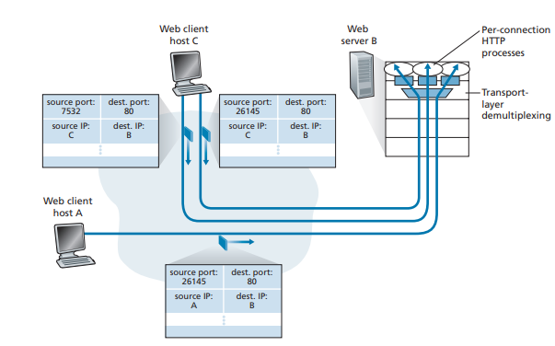
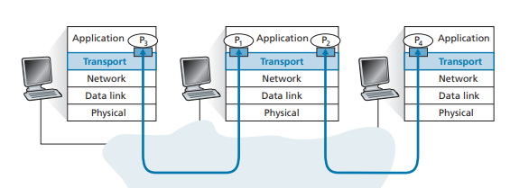
Connection-Oriented Multiplexing and Demultiplexing
Two clients, using the same destination port number (80) to communicate with the same Web server application
Transport-layer multiplexing and demultiplexing

Slide 7

Multiplexing/demultiplexing
multiplexing at sender:
demultiplexing at receiver:
handle data from multiple
sockets, add transport header (later used for demultiplexing)
use header info to deliver
received segments to correct
socket
application
application
P1
P2
application
socket
P3
transport
P4
process
transport
network
transport
network
link
network
link
physical
link
physical
physical

Slide 8
How demultiplexing works
host receives IP datagrams
each datagram has source IP address, destination IP address
each datagram carries one transport-layer segment
each segment has source, destination port number
host uses IP addresses & port numbers to direct segment to appropriate socket
32 bits
source port #
dest port #
other header fields
application
data
(payload)
TCP/UDP segment format

Slide 9
Connectionless demultiplexing
clientSocket = socket(AF_INET, SOCK_DGRAM)
The transport layer automatically assigns a port number to the socket. In particular, the transport layer assigns a port number in the range 1024 to 65535 that is currently not being used by any other UDP port in the host. Alternatively, we can add a line into our Python program after we create the socket to associate a specific port number (say, 19157) to this UDP socket via the socket bind() method:
clientSocket.bind((’’, 19157))
when receiving host receives UDP segment:
checks destination port # in segment
directs UDP segment to socket with that port #
when creating datagram to send into UDP socket, must specify
destination IP address
destination port #
IP/UDP datagrams with same dest. port #, but different source IP addresses and/or source port numbers will be directed to same socket at receiving host

Slide 10
Connectionless demultiplexing: an example
DatagramSocket serverSocket = new DatagramSocket
(6428);
DatagramSocket mySocket2 = new DatagramSocket
(9157);
DatagramSocket mySocket1 = new DatagramSocket (5775);
application
application
P1
application
P3
P4
transport
transport
network
transport
network
link
network
link
physical
link
physical
physical
source port: 6428
dest port: 9157
source port: ?
dest port: ?
source port: 9157
dest port: 6428
source port: ?
dest port: ?

Slide 11
Connection-oriented demultiplexing
TCP socket identified by 4-tuple:
source IP address
source port number
dest IP address
dest port number
server may support many simultaneous TCP sockets:
each socket identified by its own 4-tuple
each socket associated with a different connecting client
demux: receiver uses all four values (4-tuple) to direct segment to appropriate socket

Slide 12
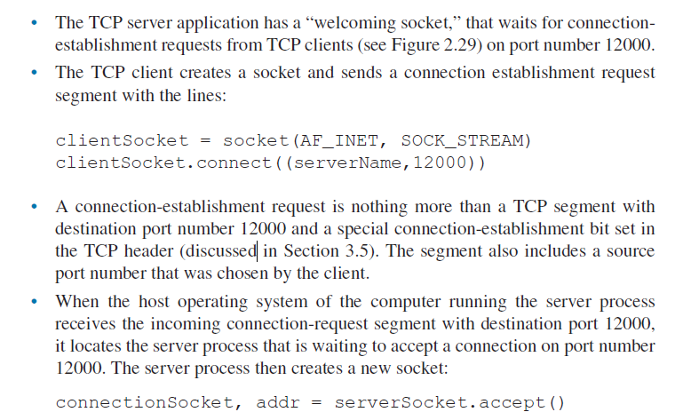
Connection-oriented demultiplexing

Slide 13
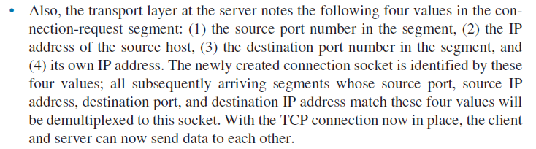

Slide 14
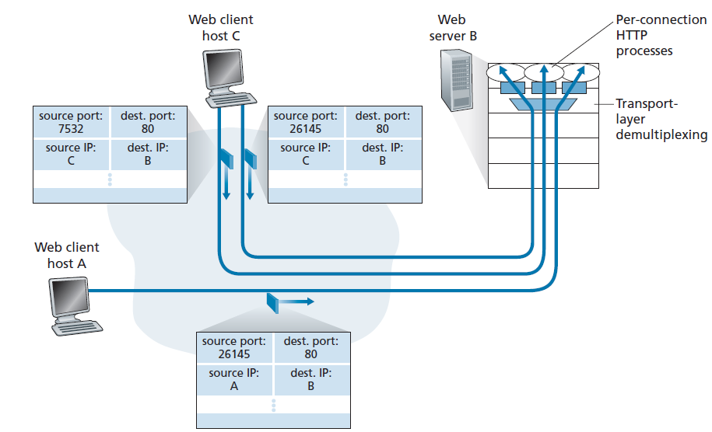
Two clients, using the same destination port number (80) to communicate with the same Web server application

Slide 15

Connection-oriented demultiplexing: example
application
application
P4
P5
P6
application
P1
P2
P3
transport
transport
network
transport
network
link
network
link
physical
link
physical
server: IP address B
physical
host: IP address A
source IP,port: B,80
dest IP,port: A,9157
host: IP address C
source IP,port: C,5775
dest IP,port: B,80
source IP,port: A,9157
dest IP, port: B,80
source IP,port: C,9157
dest IP,port: B,80
Three segments, all destined to IP address: B,
dest port: 80 are demultiplexed to different sockets

Slide 16
Summary
Multiplexing, demultiplexing: based on segment, datagram header field values
UDP: demultiplexing using destination port number (only)
TCP: demultiplexing using 4-tuple: source and destination IP addresses, and port numbers
Multiplexing/demultiplexing happen at all layers

Slide 17
Chapter 3: roadmap
Multiplexing and demultiplexing
Connectionless transport: UDP
Principles of reliable data transfer (Go-back-N and Selective Repeat)
Connection-oriented transport: TCP
TCP congestion control

Slide 18
UDP: User Datagram Protocol
Why is there a UDP?
“best effort” service, UDP segments may be:
lost
delivered out-of-order to app
no connection establishment (which can add RTT delay)
simple: no connection state at sender, receiver
small header size
no congestion control
UDP can blast away as fast as desired!
can function in the face of congestion
connectionless:
no handshaking between UDP sender, receiver
each UDP segment handled independently of others

Slide 19
UDP: User Datagram Protocol
UDP use:
streaming multimedia apps (loss tolerant, rate sensitive)
DNS
SNMP
HTTP/3
if reliable transfer needed over UDP (e.g., HTTP/3):
add needed reliability at application layer
add congestion control at application layer

Slide 20
UDP: Transport Layer Actions
SNMP client
SNMP server
application
application
transport
(UDP)
transport
(UDP)
network (IP)
network (IP)
link
link
physical
physical

Slide 21
UDP: Transport Layer Actions
SNMP client
SNMP server
UDP sender actions:
application
application
is passed an application-layer message
SNMP msg
transport
(UDP)
transport
(UDP)
determines UDP segment header fields values
UDP_{h}
SNMP msg
UDP_{h}
creates UDP segment
network (IP)
network (IP)
passes segment to IP
link
link
physical
physical

Slide 22
UDP: Transport Layer Actions
SNMP client
SNMP server
UDP receiver actions:
application
receives segment from IP
application
checks UDP checksum header value
transport
(UDP)
transport
(UDP)
SNMP msg
extracts application-layer message
network (IP)
network (IP)
SNMP msg
UDP_{h}
demultiplexes message up to application via socket
link
link
physical
physical

Slide 23
UDP segment Structure
32 bits
source port #
dest port #
length
checksum
application
data
(payload)
length, in bytes of UDP segment, including header
data to/from application layer
UDP segment format

Slide 24

UDP checksum
Goal: detect errors (i.e., flipped bits) in transmitted segment
1st number
2nd number
sum
Transmitted: 5 6 11
Received: 4 6 11
receiver-computed
checksum
=
sender-computed
checksum (as received)

Slide 25
UDP checksum
Goal: detect errors (i.e., flipped bits) in transmitted segment
sender:
treat contents of UDP segment (including UDP header fields and IP addresses) as sequence of 16-bit integers
checksum: addition (one’s complement sum) of segment content
checksum value put into UDP checksum field
receiver:
compute checksum of received segment
check if computed checksum equals checksum field value:
Not equal - error detected
Equal - no error detected. But maybe errors nonetheless? More later ….

Slide 26
Internet checksum: an example
example: add two 16-bit integers
1 1 1 0 0 1 1 0 0 1 1 0 0 1 1 0
1 1 0 1 0 1 0 1 0 1 0 1 0 1 0 1
wraparound
1 1 0 1 1 1 0 1 1 1 0 1 1 1 0 1 1
sum
1 0 1 1 1 0 1 1 1 0 1 1 1 1 0 0
checksum
0 1 0 0 0 1 0 0 0 1 0 0 0 0 1 1
Note: when adding numbers, a carryout from the most significant bit needs to be added to the result
* Check out the online interactive exercises for more examples: http://gaia.cs.umass.edu/kurose_ross/interactive/

Slide 27
Internet checksum: weak protection!
example: add two 16-bit integers
0 1
1 1 1 0 0 1 1 0 0 1 1 0 0 1 1 0
1 0
1 1 0 1 0 1 0 1 0 1 0 1 0 1 0 1
wraparound
1 1 0 1 1 1 0 1 1 1 0 1 1 1 0 1 1
Even though numbers have changed (bit flips), no change in checksum!
sum
1 0 1 1 1 0 1 1 1 0 1 1 1 1 0 0
checksum
0 1 0 0 0 1 0 0 0 1 0 0 0 0 1 1

Slide 28
Now you might be wondering why an application developer would ever choose to build an application over UDP rather than over TCP.
Finer application-level control over what data is sent, and when: Under UDP, as soon as an application process passes data to UDP, UDP will package the data inside a UDP segment and immediately pass the segment to the network layer.
No connection establishment: TCP uses a three-way handshake before it starts to transfer data. UDP just blasts away without any formal preliminaries. Thus UDP does not introduce any delay to establish a connection.
No connection state:TCP maintains connection state in the end systems. This connection state includes receive and send buffers, congestion-control parameters, and sequence and acknowledgment number parameters.
Small packet header overhead:The TCP segment has 20 bytes of header overhead in every segment, whereas UDP has only 8 bytes of overhead.

Slide 29
Summary: UDP
“no frills” protocol:
segments may be lost, delivered out of order
best effort service: “send and hope for the best”
UDP has its plusses:
no setup/handshaking needed (no RTT incurred)
can function when network service is compromised
helps with reliability (checksum)
build additional functionality on top of UDP in application layer (e.g., HTTP/3)

Slide 30
Chapter 3: roadmap
Multiplexing and demultiplexing
Connectionless transport: UDP
Principles of reliable data transfer (Go-back-N and Selective Repeat)
Connection-oriented transport: TCP
segment structure
reliable data transfer
flow control
connection management
TCP congestion control

Slide 31
TCP: overview RFCs: 793,1122, 2018, 5681, 7323
point-to-point:
one sender, one receiver
reliable, in-order byte steam:
no “message boundaries"
full duplex data:
bi-directional data flow in same connection
MSS: maximum segment size
cumulative ACKs
pipelining:
TCP congestion and flow control set window size
connection-oriented:
handshaking (exchange of control messages) initializes sender, receiver state before data exchange
flow controlled:
sender will not overwhelm receiver
Notes:
Typical MSS is 1460 bytes

Slide 32
TCP segment structure
32 bits
source port #
dest port #
segment seq #: counting bytes of data into bytestream (not segments!)
ACK: seq # of next expected byte; A bit: this is an ACK
sequence number
acknowledgement number
length (of TCP header)
head
len
not
used
A
P
S
receive window
flow control: # bytes receiver willing to accept
C
E
U
R
F
Internet checksum
checksum
Urg data pointer
options (variable length)
C, E: congestion notification
TCP options
application
data
(variable length)
data sent by application into TCP socket
RST, SYN, FIN: connection management

Slide 33
TCP sequence numbers, ACKs
outgoing segment from sender
Sequence numbers:
byte stream “number” of first byte in segment’s data
source port #
dest port #
sequence number
acknowledgement number
rwnd
checksum
urg pointer
window size
N
Acknowledgements:
seq # of next byte expected from other side
cumulative ACK
sender sequence number space
sent
ACKed
sent, not-yet ACKed
(“in-flight”)
usable
but not
yet sent
not
usable
Q: how receiver handles out-of-order segments
A: TCP spec doesn’t say, - up to implementor
outgoing segment from receiver
source port #
dest port #
sequence number
acknowledgement number
A
rwnd
checksum
urg pointer

Slide 34
TCP sequence numbers, ACKs
Host A
Host B
User types‘C’
Seq=42, ACK=79, data = ‘C’
host ACKs receipt of‘C’, echoes back ‘C’
Seq=79, ACK=43, data = ‘C’
host ACKs receipt of echoed ‘C’
Seq=43, ACK=80
simple telnet scenario
Notes:
The key thing to note here is that the ACK number (43) on the B-to-A segment is one more than the sequence number (42) on the A-toB segment that triggered that ACK
Similarly, the ACK number (80) on the last A-to-B segment is one more than the sequence number (79) on the B-to-A segment that triggered that ACK

Slide 35
TCP round trip time, timeout
Q: how to set TCP timeout value?
longer than RTT, but RTT varies!
too short: premature timeout, unnecessary retransmissions
too long: slow reaction to segment loss
Q: how to estimate RTT?
SampleRTT:measured time from segment transmission until ACK receipt
ignore retransmissions
SampleRTT will vary, want estimated RTT “smoother”
average several recent measurements, not just current SampleRTT

Slide 36
TCP round trip time, timeout
EstimatedRTT = (1- α)*EstimatedRTT + α*SampleRTT
exponential weighted moving average (EWMA)
influence of past sample decreases exponentially fast
typical value: α = 0.125
RTT: gaia.cs.umass.edu to fantasia.eurecom.fr
RTT (milliseconds)
sampleRTT
EstimatedRTT
time (seconds)
Notes:
This is how TCP re-computes the estimated RTT each time a new SampleRTT is taken.
The process is knows as an exponeitally weighted moving average, shown by the equation here.
<say it>
Where alpha reflects the influence of the most recent measurements on the estimated RTT; a typical value of alpha used in implementaitons is .125
The graph at the bottom show measured RTTs beween a host in the Massachusetts and a host in France, as well as the estimated, “smoothed” RTT

Slide 37

TCP round trip time, timeout
timeout interval: EstimatedRTT plus “safety margin”
large variation in EstimatedRTT: want a larger safety margin
TimeoutInterval = EstimatedRTT + 4*DevRTT
estimated RTT
“safety margin”
DevRTT: EWMA of SampleRTT deviation from EstimatedRTT:
DevRTT = (1-β)*DevRTT + β*|SampleRTT-EstimatedRTT|
(typically, β = 0.25)
* Check out the online interactive exercises for more examples: http://gaia.cs.umass.edu/kurose_ross/interactive/
Notes:
Given this value of the estimated RTT, TCP computes the timeout interval to be the estimated RTT plus a “safety margin”
And the intuition is that if we are seeing a large variation in SAMPLERTT – the RTT estimates are fluctuating a lot - then we’ll want a larger savety margin
So TCP computes the Timeout interval to be the Estimated RTT plus 4 times a measure of deviation in the RTT.
The deviation in the RTT is computed as the eWMA of the difference between the most recently measured SampleRTT from the Estimated RTT

Slide 38
TCP Sender (simplified)
event: data received from application
create segment with seq #
seq # is byte-stream number of first data byte in segment
start timer if not already running
think of timer as for oldest unACKed segment
expiration interval: TimeOutInterval
event: timeout
retransmit segment that caused timeout
restart timer
event: ACK received
if ACK acknowledges previously unACKed segments
update what is known to be ACKed
start timer if there are still unACKed segments
Notes:
Given these details of TCP sequence numbers, acks, and timers, we can now describe the big picture view of how the TCP sender and receiver operate
You can check out FSMs in book; let’s just give an English text description here and let’s start with the sender.

Slide 39
TCP Receiver: ACK generation [RFC 5681]
Event at receiver
arrival of in-order segment with
expected seq #. All data up to
expected seq # already ACKed
arrival of in-order segment with
expected seq #. One other
segment has ACK pending
arrival of out-of-order segment
higher-than-expect seq. # .
Gap detected
arrival of segment that
partially or completely fills gap
TCP receiver action
delayed ACK. Wait up to 500ms
for next segment. If no next segment,
send ACK
immediately send single cumulative
ACK, ACKing both in-order segments
immediately send duplicate ACK,
indicating seq. # of next expected byte
immediate send ACK, provided that
segment starts at lower end of gap
Notes:
Rather than immediately ACKnowledig this segment, many TCP implementations will wait for half a second for another in-order segment to arrive, and then generate a single cumulative ACK for both segments – thus decreasing the amount of ACK traffic. The arrival of this second in-order segment and the cumulative ACK generation that covers both segments is the second row in this table.

Slide 40
TCP: retransmission scenarios
Host A
Host B
Host A
Host B
SendBase=92
Seq=92, 8 bytes of data
Seq=92, 8 bytes of data
timeout
timeout
Seq=100, 20 bytes of data
ACK=100
X
ACK=100
ACK=120
Seq=92, 8 bytes of data
Seq=92, 8
bytes of data
SendBase=100
send cumulative
ACK for 120
SendBase=120
ACK=100
ACK=120
SendBase=120
lost ACK scenario
premature timeout
Notes:
To cement our understanding of TCP reliability, let’s look a a few retransmission scenarios
In the first case a TCP segments is transmited and the ACK is lost, and the TCP timeout mechanism results in another copy of being transmitted and then re-ACKed a the sender
In the second example two segments are sent and acknowledged, but there is a premature timeout e for the first segment, which is retransmitted. Notet that when this retransmitted segment is received, the receiver has already received the first two segments, and so resends a cumulative ACK for both segments received so far, rather than an ACK for just this fist segment.

Slide 41
TCP: retransmission scenarios
Host A
Host B
Seq=92, 8 bytes of data
Seq=100, 20 bytes of data
ACK=100
X
ACK=120
Seq=120, 15 bytes of data
cumulative ACK covers for earlier lost ACK
Notes:
And in this last example, two segments are again transmitted, the first ACK is lost but the second ACK, a cumulative ACK arrives at the sender, which then can transmit a third segment, knowing that the first two have arrived, even though the ACK for the first segment was lost

Slide 42

TCP fast retransmit
Host A
Host B
TCP fast retransmit
if sender receives 3 additional ACKs for same data (“triple duplicate ACKs”), resend unACKed segment with smallest seq #
likely that unACKed segment lost, so don’t wait for timeout
Seq=92, 8 bytes of data
Seq=100, 20 bytes of data
X
ACK=100
timeout
ACK=100
ACK=100
Receipt of three duplicate ACKs indicates 3 segments received after a missing segment – lost segment is likely. So retransmit!
ACK=100
Seq=100, 20 bytes of data
Notes:
Let’s wrap up our study of TCP reliability by discussing an optimization to the original TCP known as TCP fast retransmit,
Take a look at this example on the right where 5 segments are transmitted and the second segment is lost. In this case the TCP receiver sends an ACK 100 acknowledging the first received segment.
When the third segment arrives at the receiver, the TCP receiver sends another ACK 100 since the second segment has not arrived. And similarly for the 4th and 5th segments to arrive.
Now what does the sender see? The sender receives the first ACK 100 it has been hoping for, but then three additional duplicate ACK100s arrive. The sender knows that somethings’ wrong – it knows the first segment arrived at the receiver but three later arriving segments at the receiver – the ones that generated the three duplicate ACKs – we received correctly but were not in order. That is, that there was a missing segment at the receiver when each of the three duplicate ACK were generated.
With fast retransmit, the arrival of three duplicate ACK causes the sender to retransmit its oldest unACKed segment, without waiting for a timeout event. This allows TCP to recover more quickly from what is very likely a loss event
specifically that the second segment has been lost, since three higher -numbered segments were received

Slide 43
Chapter 3: roadmap
Transport-layer services
Multiplexing and demultiplexing
Connectionless transport: UDP
Principles of reliable data transfer
Connection-oriented transport: TCP
segment structure
reliable data transfer
flow control
connection management
Principles of congestion control
TCP congestion control

Slide 44
TCP flow control
Q: What happens if network layer delivers data faster than application layer removes data from socket buffers?
TCP provides flow control by having the sender maintain a variable called the receive window. Informally, the receive window is used to give the sender an idea of how much free buffer space is available at the receiver. Because TCP is full-duplex, the sender at each side of the connection maintains a distinct receive window.
TCP provides a flow-control service to its applications to eliminate the possibility of the sender overflowing the receiver’s buffer. Flow control is thus a speedmatching service—matching the rate at which the sender is sending against the rate at which the receiving application is reading
Suppose that Host A is sending a large file to Host B over a TCP connection. Host B allocates a receive buffer to this connection; denote its size by RcvBuffer. From time to time, the application process in Host B reads from the buffer. Define the
following variables:
• LastByteRead: the number of the last byte in the data stream read from the buffer by the application process in B
• LastByteRcvd: the number of the last byte in the data stream that has arrived from the network and has been placed in the receive buffer at B
Notes:
(Presuming an intro)
Before diving into the details of TCP flow control, let’s first get the general context and motivate the need for flow control.
This diagram show a typical transport-layer implementation
A segment is brought up the protocol stack to the transport layer, and the segment’s payload is removed from the segment and written INTO socket buffers.
How does data get taken OUT of socket buffers? By applications performing socket reads, as we learned in Chapter 2.
And so the question is “What happens if network layer delivers data faster than an application-layer process removes data from socket buffers?”
Let’s watch a video of what happens when things arrive way too fast to fast to be processed.
<video>. (I love that video). Another human analogy showing the need for flow control is the saying – to use some English slang - “no one can drink from a firehose”
Flow control is a mechanism to the calamity of a receiver being over-run by a sender that is sending too fast – it allows the RECEIVER to explictly control the SENDER so sender won’t overflow receiver’s buffer by transmitting too much, too fast

Slide 45
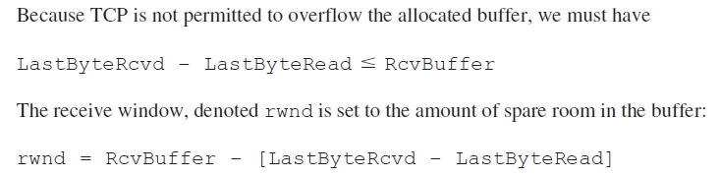
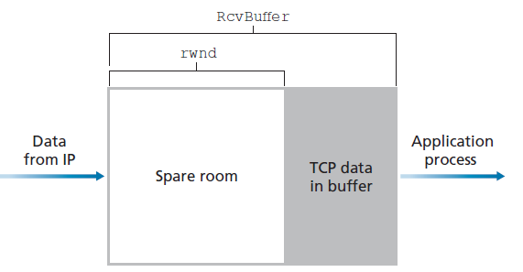
LastByteSent – LastByteAcked <=rwnd

Slide 46
TCP Connection Management The TCP in the client then proceeds to establish a TCP connection with the TCP in the server in the following manner:
Step 1. The client-side TCP first sends a special TCP segment to the server-side TCP. This special segment contains no application-layer data. But one of the flag bits in the segment’s header, the SYN bit, is set to 1. For this reason, this special segment is referred to as a SYN segment. In addition, the client randomly chooses an initial sequence number (client_isn) and puts this number in the sequence number field of the initial TCP SYN segment.
Step 2. Once the IP datagram containing the TCP SYN segment arrives at the server host (assuming it does arrive!), the server extracts the TCP SYN segment from the datagram, allocates the TCP buffers and variables to the connection, and sends a connection-granted segment to the client TCP. (We’ll see in Chapter 8 that the allocation of these buffers and variables before completing the third step of the three-way handshake makes TCP vulnerable to a denial-of-service attack known as SYN flooding.) This connection-granted segment also contains no application-layer data. However, it does contain three important pieces of information in the segment header. First, the SYN bit is set to 1. Second, the acknowledgment field of the TCP segment header is set to client_isn+1. Finally, the server chooses its own initial sequence number (server_isn) and puts this value in the sequence number field of the TCP segment header
Step 3. Upon receiving the SYNACK segment, the client also allocates buffers and variables to the connection. The client host then sends the server yet another segment; this last segment acknowledges the server’s connection-granted segment (the client does so by putting the value server_isn+1 in the acknowledgment The SYN bit is set to zero, since the connection is established. This third stage of the three-way handshake may carry client-to-server data in the segment payload.

Slide 47
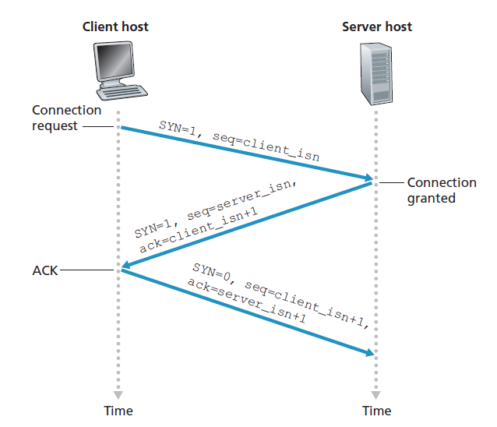
TCP three-way handshake: segment exchange

Slide 48
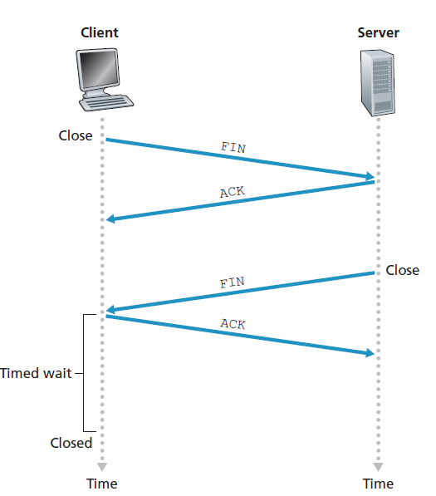
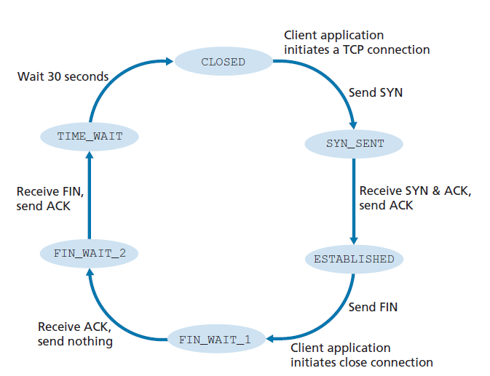
Closing a TCP connection
A typical sequence of TCP states visited by a client TCP

Slide 49
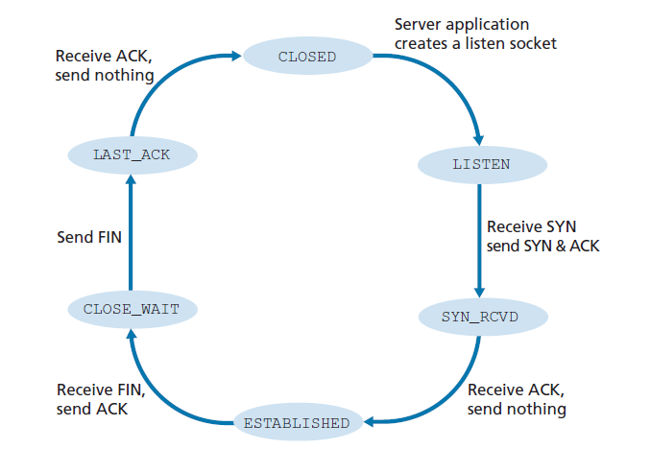
A typical sequence of TCP states visited by a server-side TCP

Slide 50
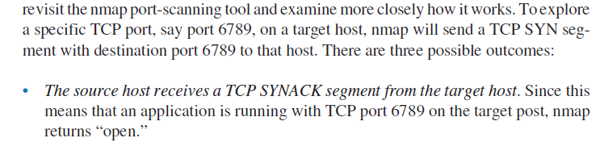
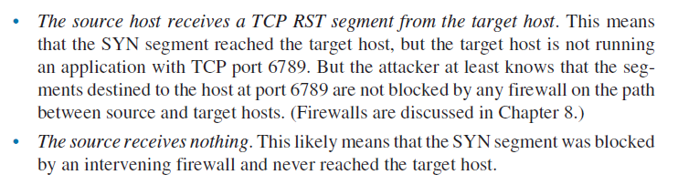

Slide 51
Closing a TCP connection
client, server each close their side of connection
send TCP segment with FIN bit = 1
respond to received FIN with ACK
on receiving FIN, ACK can be combined with own FIN
simultaneous FIN exchanges can be handled
Notes:
All good things must come to an end, and that’s true for a TCP connection as well.
And of course there’s a protocol for one side to gracefully close of a TCP connection using a FIN message, to which the other side sends a FINACK message and waits around a bit to respond to any retransmitted FIN messages before timing out.

Slide 52
Chapter 3: roadmap
Multiplexing and demultiplexing
Connectionless transport: UDP
Principles of reliable data transfer (Go-back-N and Selective Repeat)
Connection-oriented transport: TCP
TCP congestion control
TCP congestion control

Slide 53
TCP congestion control: AIMD
approach: senders can increase sending rate until packet loss (congestion) occurs, then decrease sending rate on loss event
Additive Increase
Multiplicative Decrease
increase sending rate by 1 maximum segment size every RTT until loss detected
cut sending rate in half at each loss event
AIMD sawtooth
behavior: probing
for bandwidth
TCP sender Sending rate
time

Slide 54
TCP AIMD: more
Multiplicative decrease detail: sending rate is
Cut in half on loss detected by triple duplicate ACK (TCP Reno)
Cut to 1 MSS (maximum segment size) when loss detected by timeout (TCP Tahoe)
Why AIMD?
AIMD – a distributed, asynchronous algorithm – has been shown to:
optimize congested flow rates network wide!
have desirable stability properties

Slide 55
TCP congestion control: details
sender sequence number space
TCP sending behavior:
roughly: send cwnd bytes, wait RTT for ACKS, then send more bytes
cwnd
last byte
ACKed
cwnd
sent, but not-yet ACKed
(“in-flight”)
available but not used
TCP rate
~
bytes/sec
~
RTT
last byte sent
TCP sender limits transmission:
cwnd is dynamically adjusted in response to observed network congestion (implementing TCP congestion control)
<
cwnd
LastByteSent- LastByteAcked

Slide 56
TCP slow start
Host A
Host B
when connection begins, increase rate exponentially until first loss event:
initially cwnd = 1 MSS
double cwnd every RTT
done by incrementing cwnd for every ACK received
one segment
RTT
two segments
four segments
summary: initial rate is slow, but ramps up exponentially fast
time

Slide 57
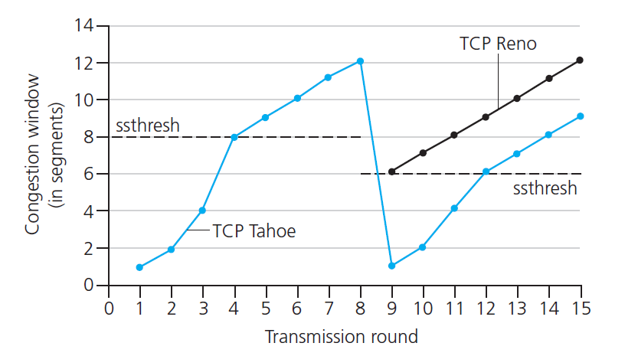

TCP: from slow start to congestion avoidance
Q: when should the exponential increase switch to linear?
A: when cwnd gets to 1/2 of its value before timeout.
X
Implementation:
variable ssthresh
on loss event, ssthresh is set to 1/2 of cwnd just before loss event
* Check out the online interactive exercises for more examples: http://gaia.cs.umass.edu/kurose_ross/interactive/

Slide 58


Summary: TCP congestion control
New
ACK!
New
ACK!
.
duplicate ACK
new ACK
dupACKcount++
new ACK
cwnd = cwnd + MSS (MSS/cwnd)
dupACKcount = 0
transmit new segment(s), as allowed
cwnd = cwnd+MSS
dupACKcount = 0
transmit new segment(s), as allowed
Λ
cwnd = 1 MSS
ssthresh = 64 KB
dupACKcount = 0
cwnd > ssthresh
slow
start
Λ
congestion
avoidance
timeout
ssthresh = cwnd/2
cwnd = 1 MSS
dupACKcount = 0
retransmit missing segment
duplicate ACK
timeout
dupACKcount++
ssthresh = cwnd/2
cwnd = 1 MSS
dupACKcount = 0
retransmit missing segment
timeout
New
ACK!
ssthresh = cwnd/2
cwnd = 1
dupACKcount = 0
retransmit missing segment
New ACK
dupACKcount == 3
cwnd = ssthresh
dupACKcount = 0
dupACKcount == 3
ssthresh= cwnd/2
cwnd = ssthresh + 3
retransmit missing segment
ssthresh= cwnd/2
cwnd = ssthresh + 3
retransmit missing segment
fast
recovery
duplicate ACK
cwnd = cwnd + MSS
transmit new segment(s), as allowed

